Slide 1

Enhancing Information Security
Proactive detection, vulnerability remediation, and systematic risk management
Presented by Minahil Azaz & Syeda Um e Farwa
Email: minahilazaz45@gmail.com & umahfarwa@gmail.com
Notes:
null

Slide 2

Introduction
1
Rising Cyber Threats
2
Vulnerability Exploitation
Frequency and sophistication of cyberattacks constantly increasing
Can lead to significant data breaches and financial losses
3
Risk Management
Proactive approach reduces impact of security incidents
Notes:
null

Slide 3



Objectives
Early Detection
Prompt Remediation
Risk Assessment
Identify vulnerabilities before they can be exploited.
Quickly fix vulnerabilities to reduce risk.
Evaluate and mitigate potential threats.
Notes:
null

Slide 4




Proactive Detection
SIEM Systems
Collect and analyze security logs
IDS/IPS
Detect and prevent network intrusions
Threat Intelligence
Gain insights into emerging threats
Notes:
null

Slide 5
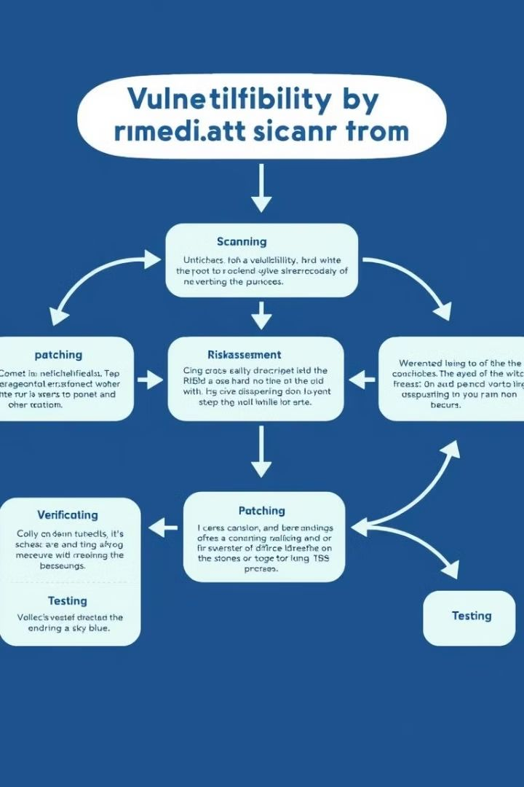
Vulnerability Remediation
Scanning
1
Identify vulnerabilities in systems and applications
Patching
2
Apply security updates to address known vulnerabilities
Testing
3
Validate security controls through penetration testing
Notes:
null

Slide 6
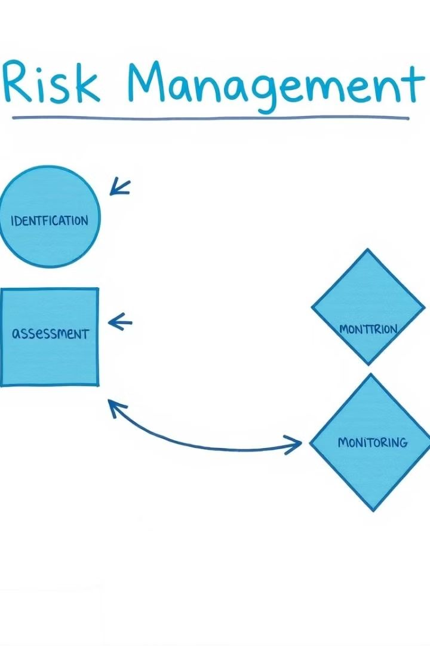




Systematic Risk Management
Risk Assessment
Identify and analyze potential security risks
Mitigation Planning
Develop strategies to reduce identified risks
Implementation
Put mitigation strategies into action
Monitoring
Continuously review and adjust risk management approach
Notes:
null

Slide 7

Information Security Frameworks
Framework
Key Features
ISO 27001
ISMS establishment and maintenance
NIST
Identify, protect, detect, respond, recover
COBIT
IT alignment with business goals
Notes:
null

Slide 8


Machine Learning in Security
Prediction
Prioritization
ML models predict potential vulnerabilities
AI algorithms prioritize critical security issues
Optimization
ML optimizes resource allocation for security tasks
Notes:
null

Slide 9
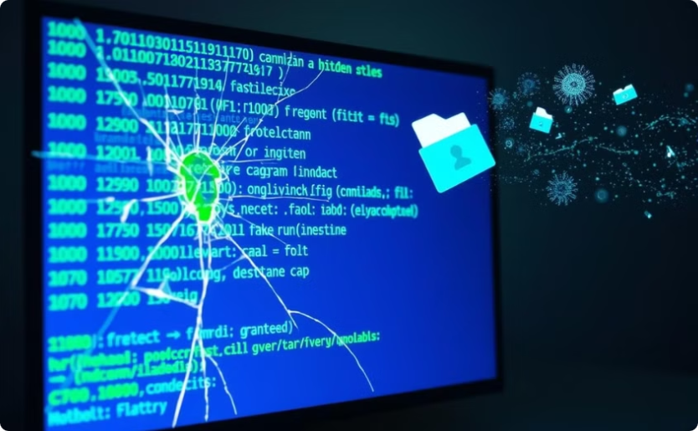
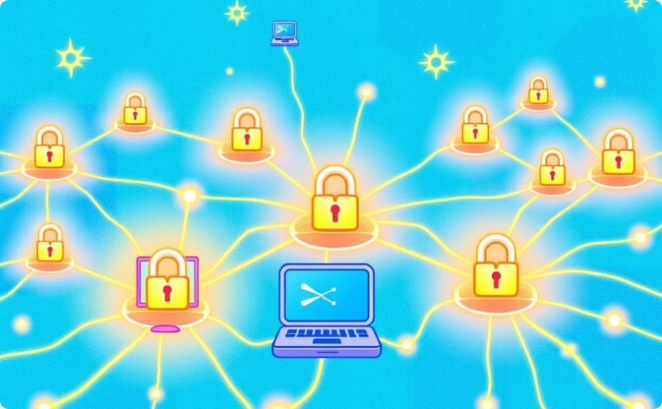
Case Studies
Data Breach Consequences
Strong Security Importance
Lessons from Saudi Aramco, eBay, and Ashley Madison
Highlighting the need for robust security measures
Notes:
null

Slide 10

Preliminary Results
1
Improved Detection
2
Resource Optimization
3
Cost Savings
ML models increased early detection rates significantly
AI-driven prioritization led to efficient resource allocation
Overall security costs reduced through ML implementation
Notes:
null

Slide 11
Conclusion
Proactive information security is essential:
Early detection and remediation are crucial:
Systematic risk management is necessary:
Organizations must prioritize information security to protect their assets and data.
Identifying and addressing vulnerabilities promptly reduces security risks.
A structured approach to risk assessment and mitigation is essential for effective security.
Notes:
null

Slide 12
Conclusion
Leveraging information security frameworks is beneficial:
Machine learning enhances security capabilities:
Adopting industry-recognized frameworks provides a standardized and comprehensive approach to security.
AI-driven solutions help predict vulnerabilities, prioritize critical issues, and optimize security tasks.
Notes:
null

Slide 13

Future Prospects
Information security will continue to evolve, adapting to the changing threat landscape.
Emerging technologies will drive innovation in security solutions, such as AI-powered threat detection and response.
Notes:
null

Slide 14

Notes:
null

Slide 15

Notes:
null

